Slide 1
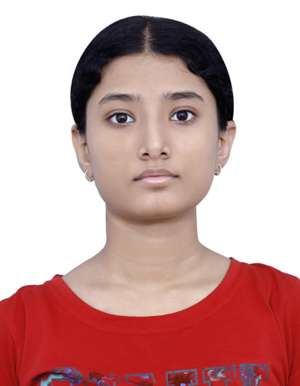

CAPSTONE PROJECT Movie Recommendation SYSTEM
Presented By
Student Name: KRITIKA BENJWAL
College Name: MANIPAL UNIVERSITY JAIPUR
Department: Computer science and engineering
Email ID: ananya.benjwal@gmail.com
AICTE Student ID:

Slide 2
OUTLINE
Problem Statement
Proposed System/Solution
System Development Approach
Algorithm & Deployment
Result
Conclusion
Future Scope
References

Slide 3
Problem Statement
Today, people are overwhelmed by the vast amount of content available on movie streaming platforms. Users often struggle to find movies that match their interests. This project addresses the challenge of delivering personalized movie recommendations based on user preferences or movie content.

Slide 4
Proposed Solution
The proposed system is a content-based recommendation engine that suggests similar movies based on their descriptions and features like title, genre, and keywords. The solution includes:
Text processing to clean and vectorize movie data
TF-IDF and cosine similarity to determine similarity
A searchable system to recommend movies based on user input

Slide 5
System Approach
Technology Used:
Python
Libraries: pandas, numpy, scikit-learn, matplotlib, seaborn, plotly
Jupyter Notebook / VS Code
Dataset: movies.csv
System Requirements:
Python 3.12+
RAM: ≥8GB recommended for optimal performance

Slide 6
Algorithm & Deployment
Algorithm:
TF-IDF Vectorizer: Converts movie overviews into feature vectors
Cosine Similarity: Measures similarity between movie vectors
Recommendation Engine: Based on top-n similarity scores
Deployment:
Local prototype via Python scripts
Scalable to web applications using Flask/Streamlit

Slide 7
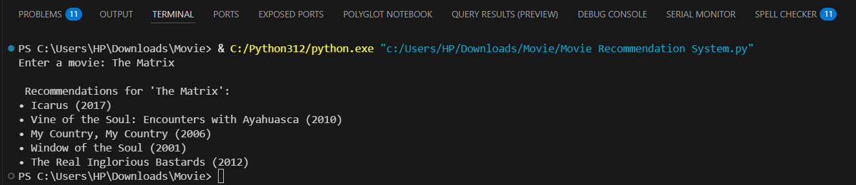
Result
A successful recommendation of similar movies when a user inputs a movie title. Example Output for "The Matrix":
Icarus (2017)
• Vine of the Soul: Encounters with Ayahuasca (2010)
• My Country, My Country (2006)
• Window of the Soul (2001)
The Real Inglorious Bastards (2012)
Minority Report :

Slide 8
Conclusion
The project successfully builds a basic content-based recommendation system using natural language processing. It provides relevant movie suggestions based on text similarity, proving useful for entertainment platforms and users alike.

Slide 9
Future scope
Integrate collaborative filtering for more accurate suggestions
Add user ratings and reviews to refine recommendations
Deploy as a web or mobile app
Include real-time personalization using user watch history

Slide 10
References
Kaggle Datasets
scikit-learn Documentation
Plotly Express
TF-IDF in NLP
GitHub

Slide 11
Thank you

